Slide 1
Statistical Analysis of Air Quality Data
Topics covered in this short video
Downloading data and reading your data into R
Descriptive statistics
Time-series plots
Scatterplots, correlation and linear regression

Slide 2
Downloading data and reading your data into R
Download data from the UK government Defra (Department for environment, food and rural affairs) website
The URL and full details can be found in the practical instructions accompanying this video
Data are downloaded as a csv (comma separated values) file, which can easily be read into R
You’ll need to do a bit of ‘cleaning’ of the file before reading it into R. This ‘cleaning’ is best done beforehand, in a spreadsheet such as excel

Slide 3
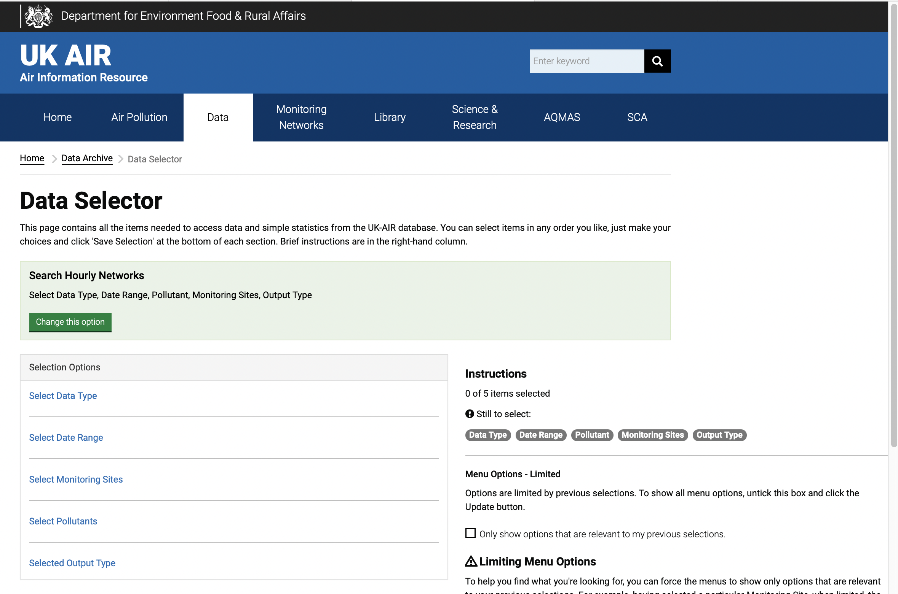
Downloading data and reading your data into R

Slide 4
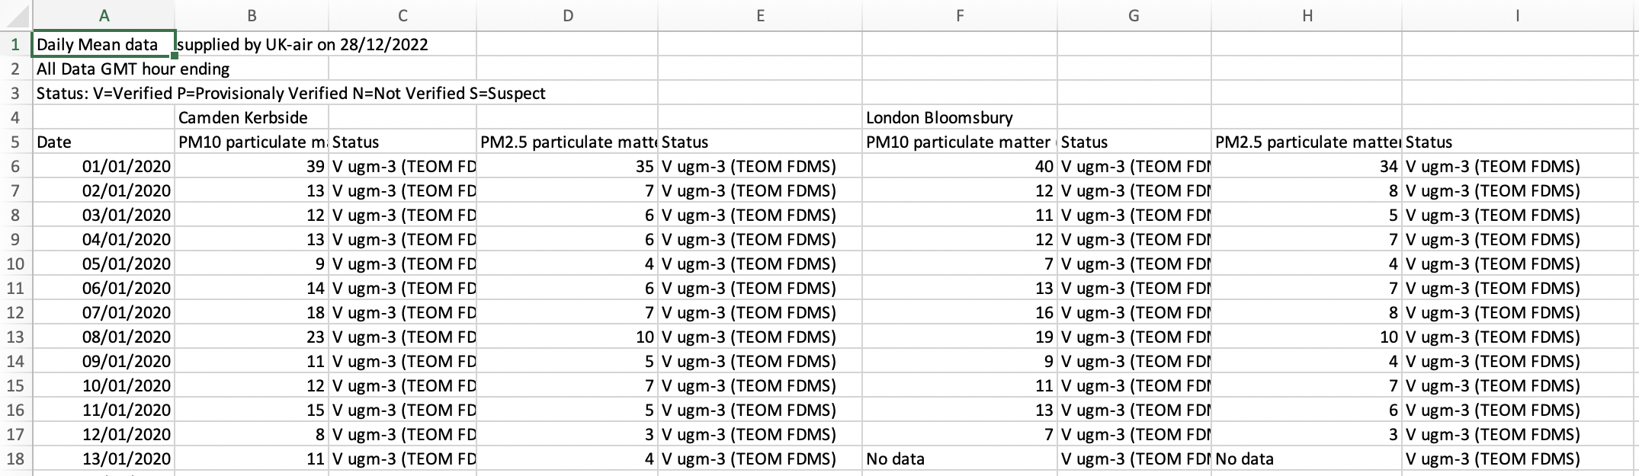
Downloading data and reading your data into R
Clean up your csv file in excel before attempting to read it into R. Remove selected columns. Remove ‘No data’ from cells.
To read data into R, use the read.csv command
NEW_FILENAME <- read.csv(”Old_file_name.csv",skip=4)

Slide 5
Descriptive statistics
Summarize your file using ‘summary’: ‘mean’ and ‘sd’ will give the mean and standard deviation, respectively, of the selected variables.
summary(YOUR_FILENAME)
mean(YOUR_FILENAME$variable_name, na.rm=TRUE)
sd(YOUR_FILENAME$variable_name, na.rm=TRUE)
Note that you must add the code ‘na.rm=TRUE” to deal with missing data (i.e. empty cells)
You can specify rows in your mean and standard deviation calculations in order to determine parameters for different quarters of the year. For example, [1:91] below calculates values for the variable in rows 1 to 91, inclusive.
mean(YOUR_FILENAME$variable_name, [1:91], na.rm=TRUE)
sd(YOUR_FILENAME$variable_name, [1:91], na.rm=TRUE)
You are asked to summarize the descriptive statistics in a table: you can make this table in excel and import it into your write-up

Slide 6
Time-series plots
A time series plot is used to plot variables as a function of time. We use plot() for this but have to take steps to deal with ‘date’ data and to joint the coordinates with a line.
plot(YOUR_FILENAME$variable_name~as.Date (YOUR_FILENAME$Date,"%d/%m/%y"))
lines(YOUR_FILENAME$ variable_name~as.Date (YOUR_FILENAME$Date,"%d/%m/%y"))
Enhance your plot (e.g. with custom axis labels and a main title, and specifying lower and upper limits to the y-axis values – useful for comparing two charts) by adding a comma after the first line of code and inserting the following code
main=”your graph’s title”
xlab=“x-axis label”
ylab=“y-axis label”
ylim=c(x,y)
ylim specifies lower (x) and upper (y) limits for the y axis.

Slide 7
Scatterplots, correlation and linear regression

Slide 8
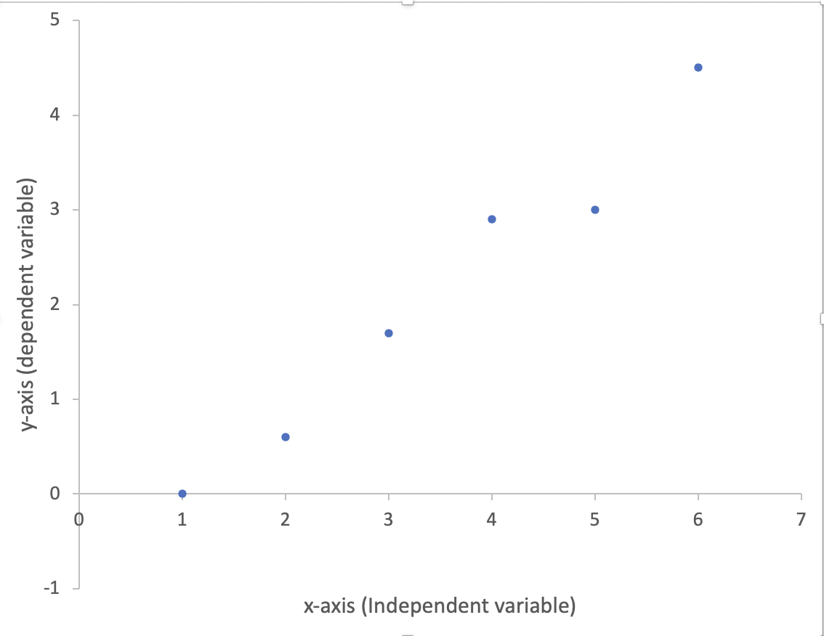



Scatterplots

Slide 9
Scatterplots
To make a basic scatterplot
plot(YOUR_FILENAME$variable_name1 ~ YOUR_FILENAME$variable_name2)
Enhance your plot (e.g. with custom axis labels and a main title) by adding a comma after “variable_name2” and inserting the following code
main=”your graph’s title”
xlab=“x-axis label”
Ylab=“y-axis label”
But, we want to add a regression line to the scatterplot, so look at the next four slides before completing your plot

Slide 10
Correlation
Correlation measures the strength of association, or covariance, between two variables. In R we use cor.test()
The default method in cor.test is the Pearson Product Moment correlation, but Spearman’s rank and Kendall’s rank are also available (method = “spearman” or “kendall”, resepctively). Decide which method is most appropriate for the data in this practical
The correlation coefficient, or R, varies between +1 (perfect positive) and -1 (perfect negative)
R² is the coefficient of determination – the amount (or proportion) of variation in the dependent variable that is explained by the independent variable
cor.test(YOUR_FILENAME$variable_name1, YOUR_FILENAME$variable_name2)

Slide 11
Correlation shown on scatterplots
Positive Negative None

Slide 12
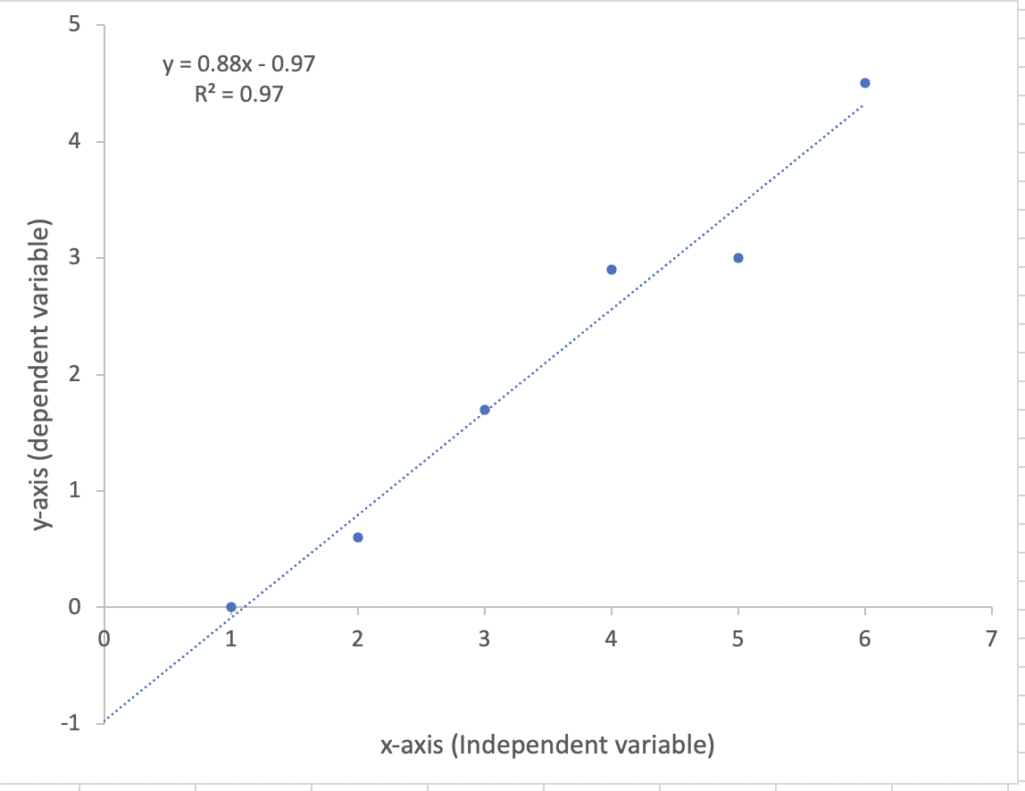

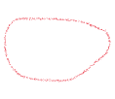
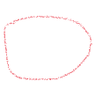
Linear regression
Regression equation and coefficient of determination
y
Gradient of the regression line: in this case, if x increases by 1, y increases by 0.88
x
Intercept of the regression line with the y axis

Slide 13
Linear regression
You now need to calculate a regression line (a linear model, or ‘lm’) and add this to your scatterplot
REGRESSION_LINE<- lm(YOUR_FILENAME$variable_name1 ~ YOUR_FILENAME$variable_name2)
“REGRESSION_LINE” is your name you choose for the regression line
Then produce your scatterplot using the code on the previous ‘scatterplot’ slide, adding the code
+abline(REGRESSION_LINE)
To obtain the coefficients (the slope and intercept) for the regression equation, use
coefficients(REGRESSION_LINE)

